Slide 1
01 – IONIC SEND JSON DATA TO PHP WEB SERVER bit.ly/ionicfgv
Tiktok.com/@khirulnizam_com

Slide 2

2-day program
Day1: Ionic with Access to Online Database
QR-code Scanner Input
Day2: SQLite local database
Save SQLite data to Online database

Slide 3
Agenda DAY1
What is JSON?
Preparing the Server-side
Online DB in MySQL
PHP script to extract JSON formatted data
IONIC processes to send JSON data

Slide 4


What is JSON formatted data?
JSON stands for JavaScript Object Notation
EXAMPLE
{"nokp":“0232323",
"nama":"ali baba",
"pendapatan":7777}'

Slide 5




Laragon={PHP, WebServer, MySQL DB} laragon.org

Slide 6
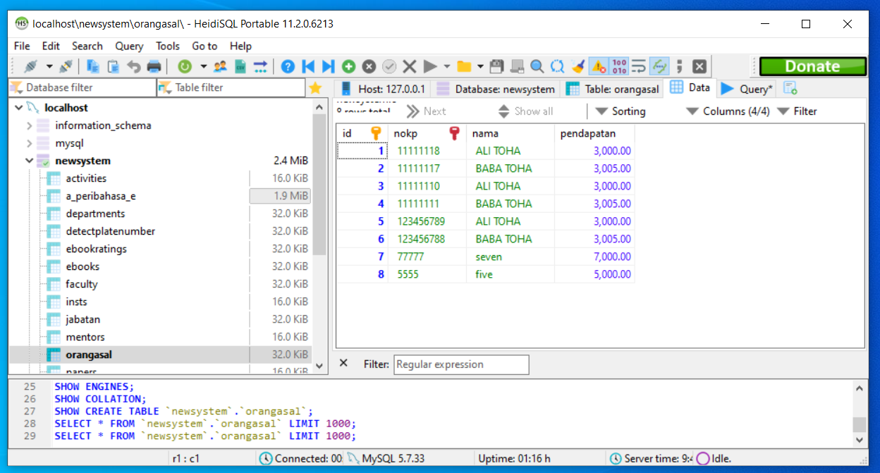
The Database

Slide 7

PHP Script
To process input from Ionic form
Create SQL to insert record into database

Slide 8
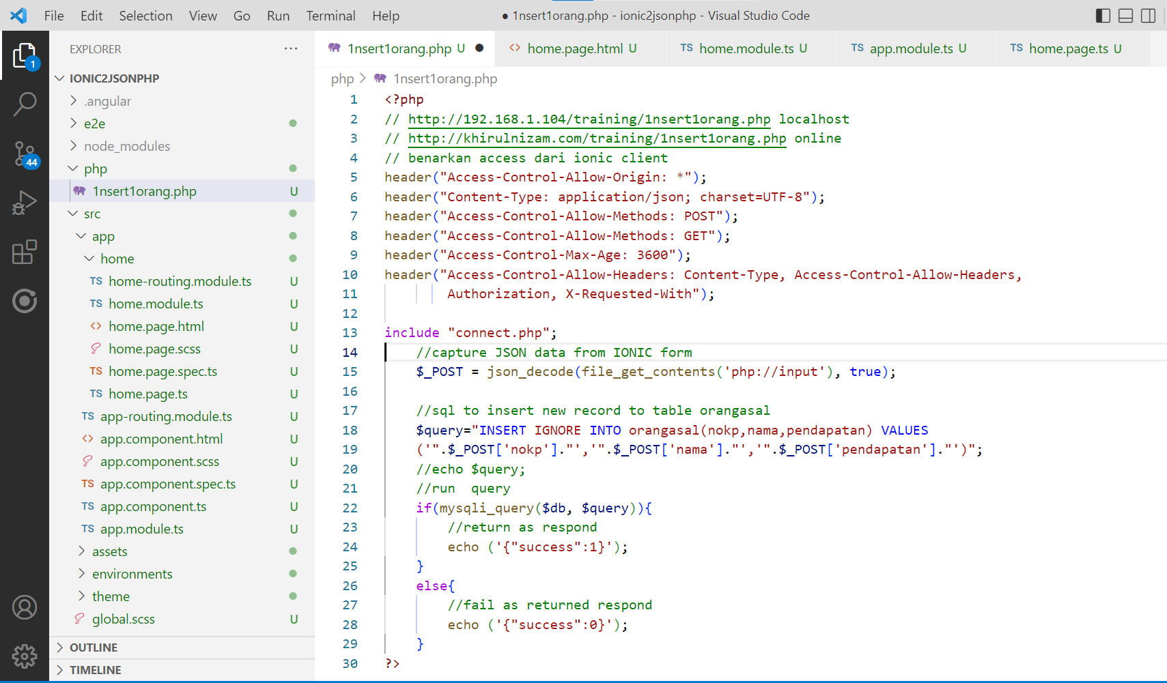
Activate CORS (cross-origin resource sharing)

Slide 9
Simple php&mysql insert record

Slide 10

Start new Ionic Project
Ionic start ion2json
Cd ion2json
Ionic serve

Slide 11
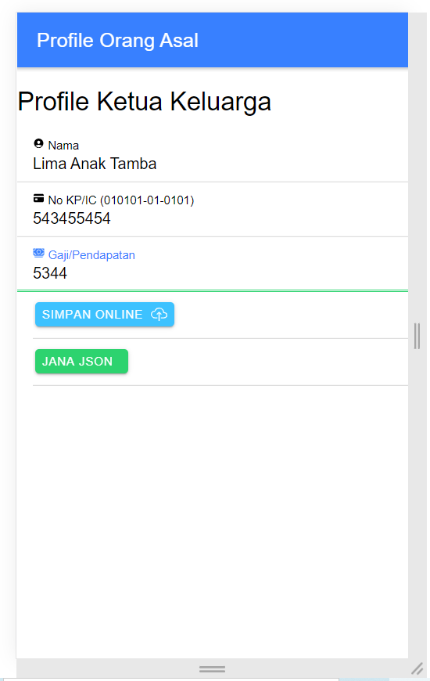
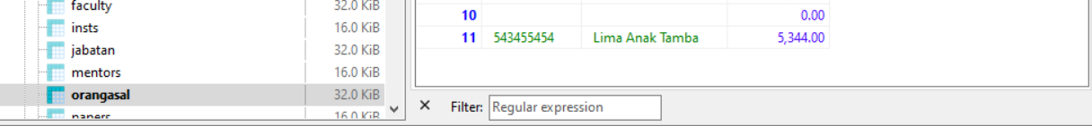
Ionic formGroup
Data:
{ nama
nokp
pendapatan }

Slide 12
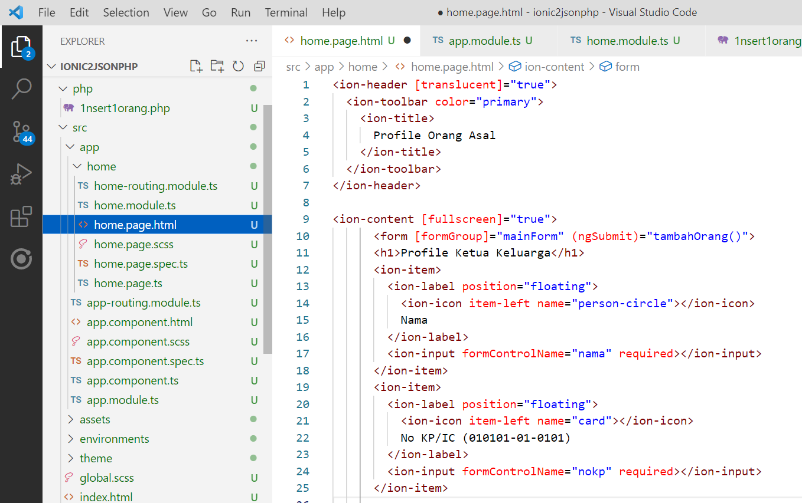
home.page.html

Slide 13
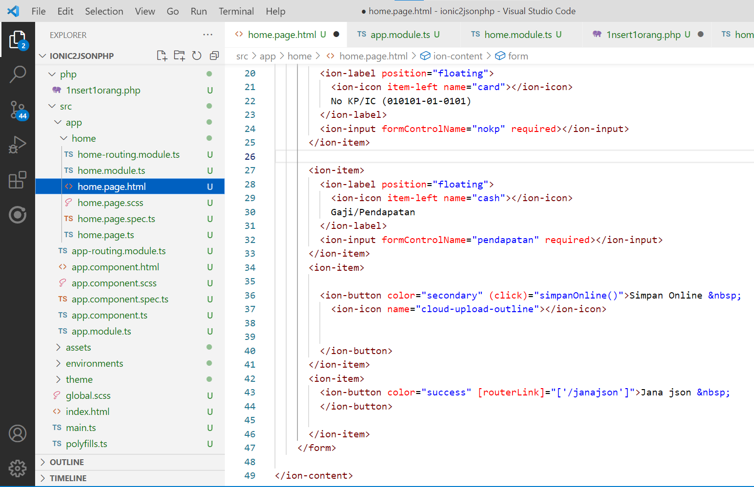
Cont… home.page.html

Slide 14
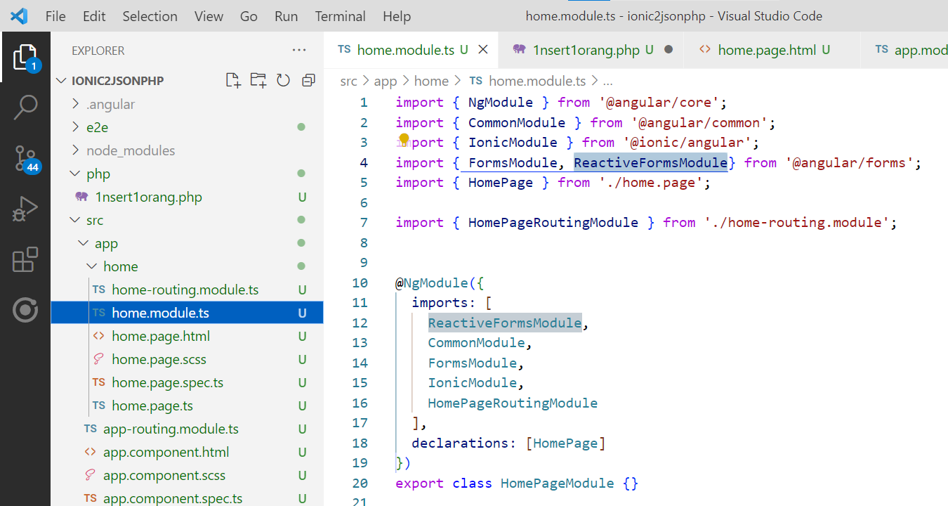
home.module.ts

Slide 15
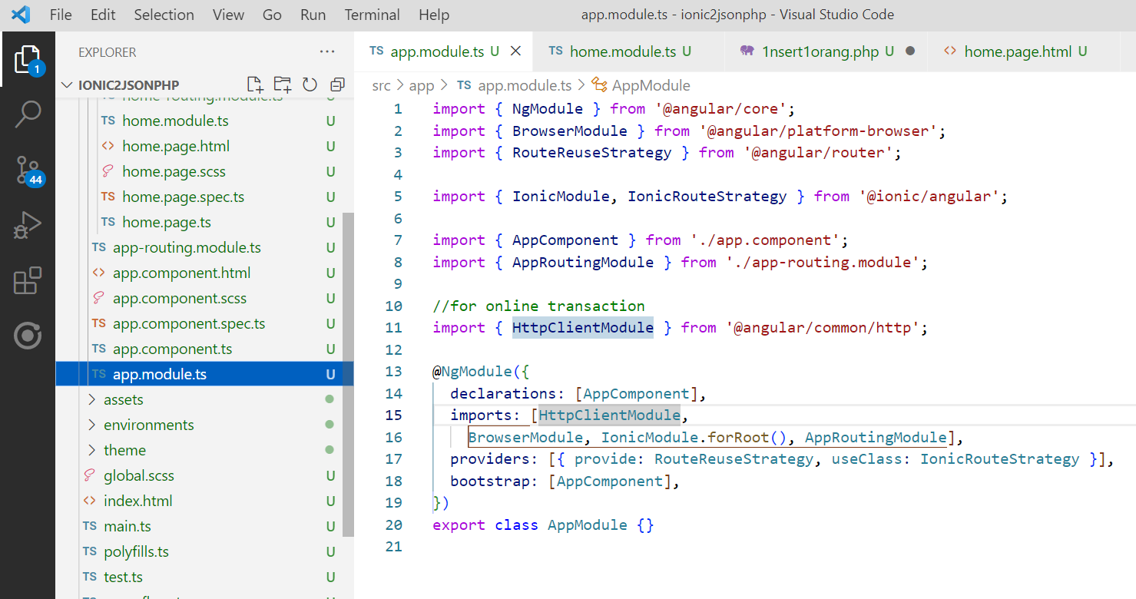
app.module.ts

Slide 16




ALL D’BEST!
Tiktok.com/@khirulnizam_com

